Slide 1
Matheus Zamberlan
Csc 595

Slide 2
Idea:
Build an app that provide to user interesting information.
For example:
Average speed
Spent Fuel
Etc.

Slide 3
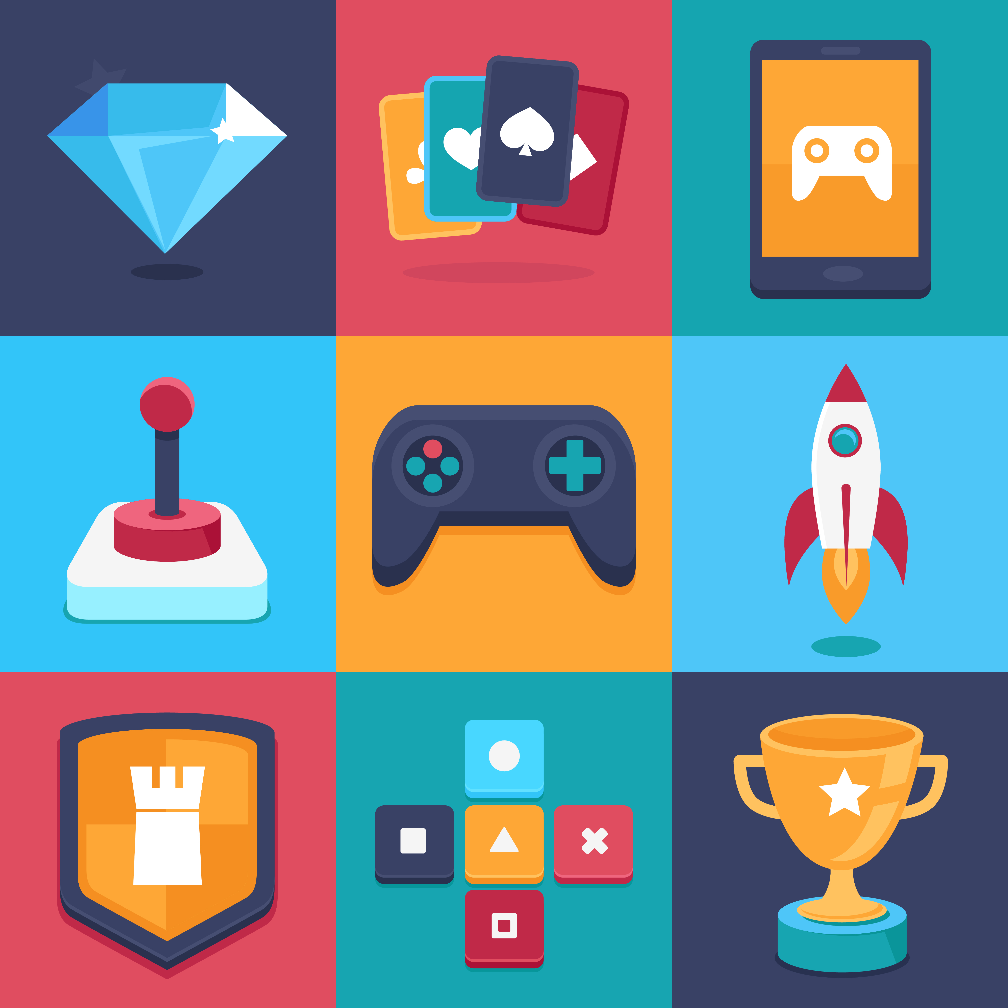
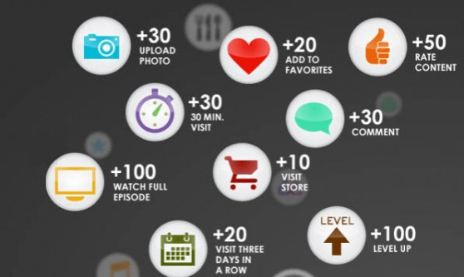
Concept: Gamification
“Gamification is the concept of applying game mechanics and game design techniques to engage and motivate people to achieve their goals.” - https://badgeville.com/wiki/Gamification

Slide 4
Why should I use that?
Important information.
Challenging.
Rewards!
After some achievements, user can earn points in Tango Card.

Slide 5
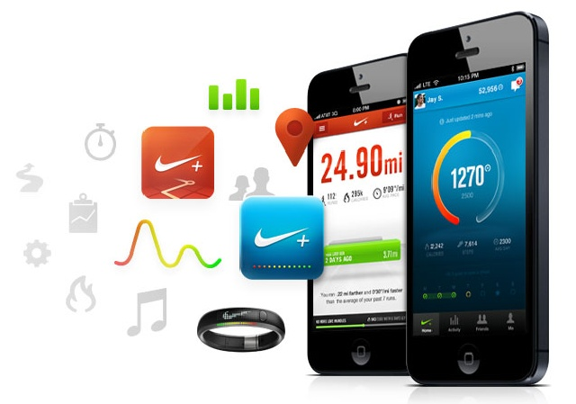


Examples of applications:
Nike+ : uses gamification to encourage and reward users who maintain an active lifestyle.
Starbucks: uses gamification to incentivize and reward customer loyalty.
Samsung: uses gamification to reward onsite visitor behavior and engagement.

Slide 6
Thank you!

